Slide 1
Harrison Sherwin vILT Setup
Notes:
This is the Managing Kubernetes Version Upgrades module.

Slide 2
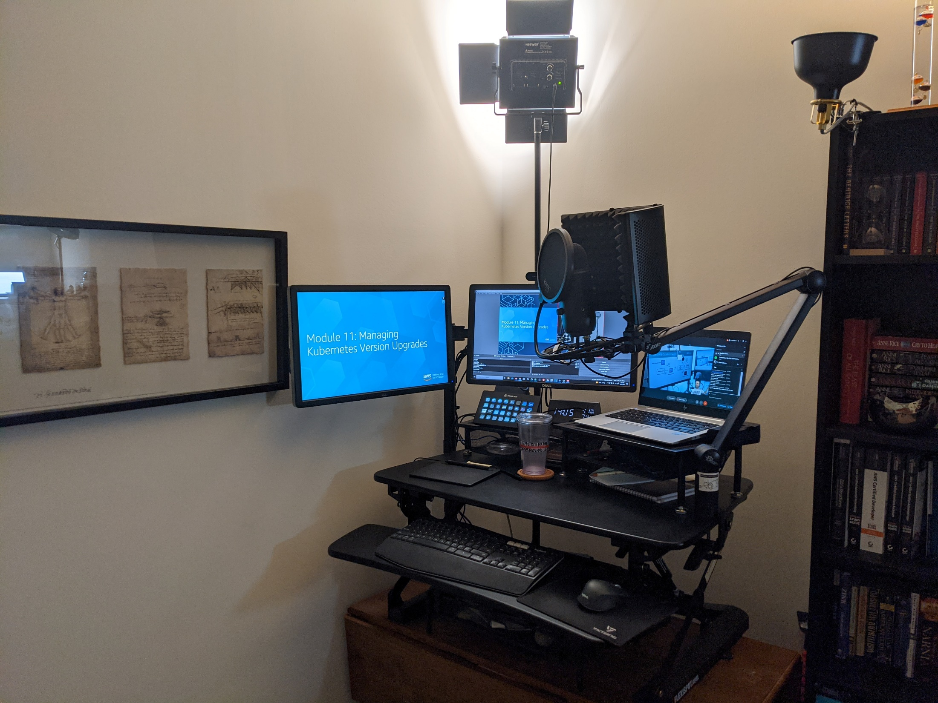
Full View
Non-Direct Lighting (Bounces Off Wall)
Accent Lighting
Noise Shield
On-Table Standing Desk Riser
Yeti Boom Arm
Random Old Table (with UPS beneath)
Old Cert Books
Notes:
Before performing an upgrade of the Kubernetes version or the Amazon EKS version of your cluster, thoroughly review the changes. Upgrade information associated with the new version. Begin your research with these sources:
AWS documentation
AWS documentation contains upgrade information and instructions for both Kubernetes version upgrades and Amazon EKS platform version upgrades. In addition to general information about upgrading, there may be requirements or procedures that are specific to Amazon EKS managed clusters. For information about upgrading Amazon EKS, see “Updating an Amazon EKS cluster Kubernetes version” in the Amazon EKS User Guide (https://docs.aws.amazon.com/eks/latest/userguide/upgrade-cluster.html).
Kubernetes documentation
For Kubernetes version upgrades, be sure to review the release notes and upgrade information in the Kubernetes documentation. The scope of change for even minor Kubernetes version upgrades can vary greatly from version to version, so be sure to properly assess the impact of the upgrade. To identify features that are being deprecated or removed, pay particular attention to changes in the Kubernetes API. For more information about Kubernetes release notes, see “v1.18 Release Notes” in the Kubernetes online documentation (https://kubernetes.io/docs/setup/release/notes/).

Slide 3
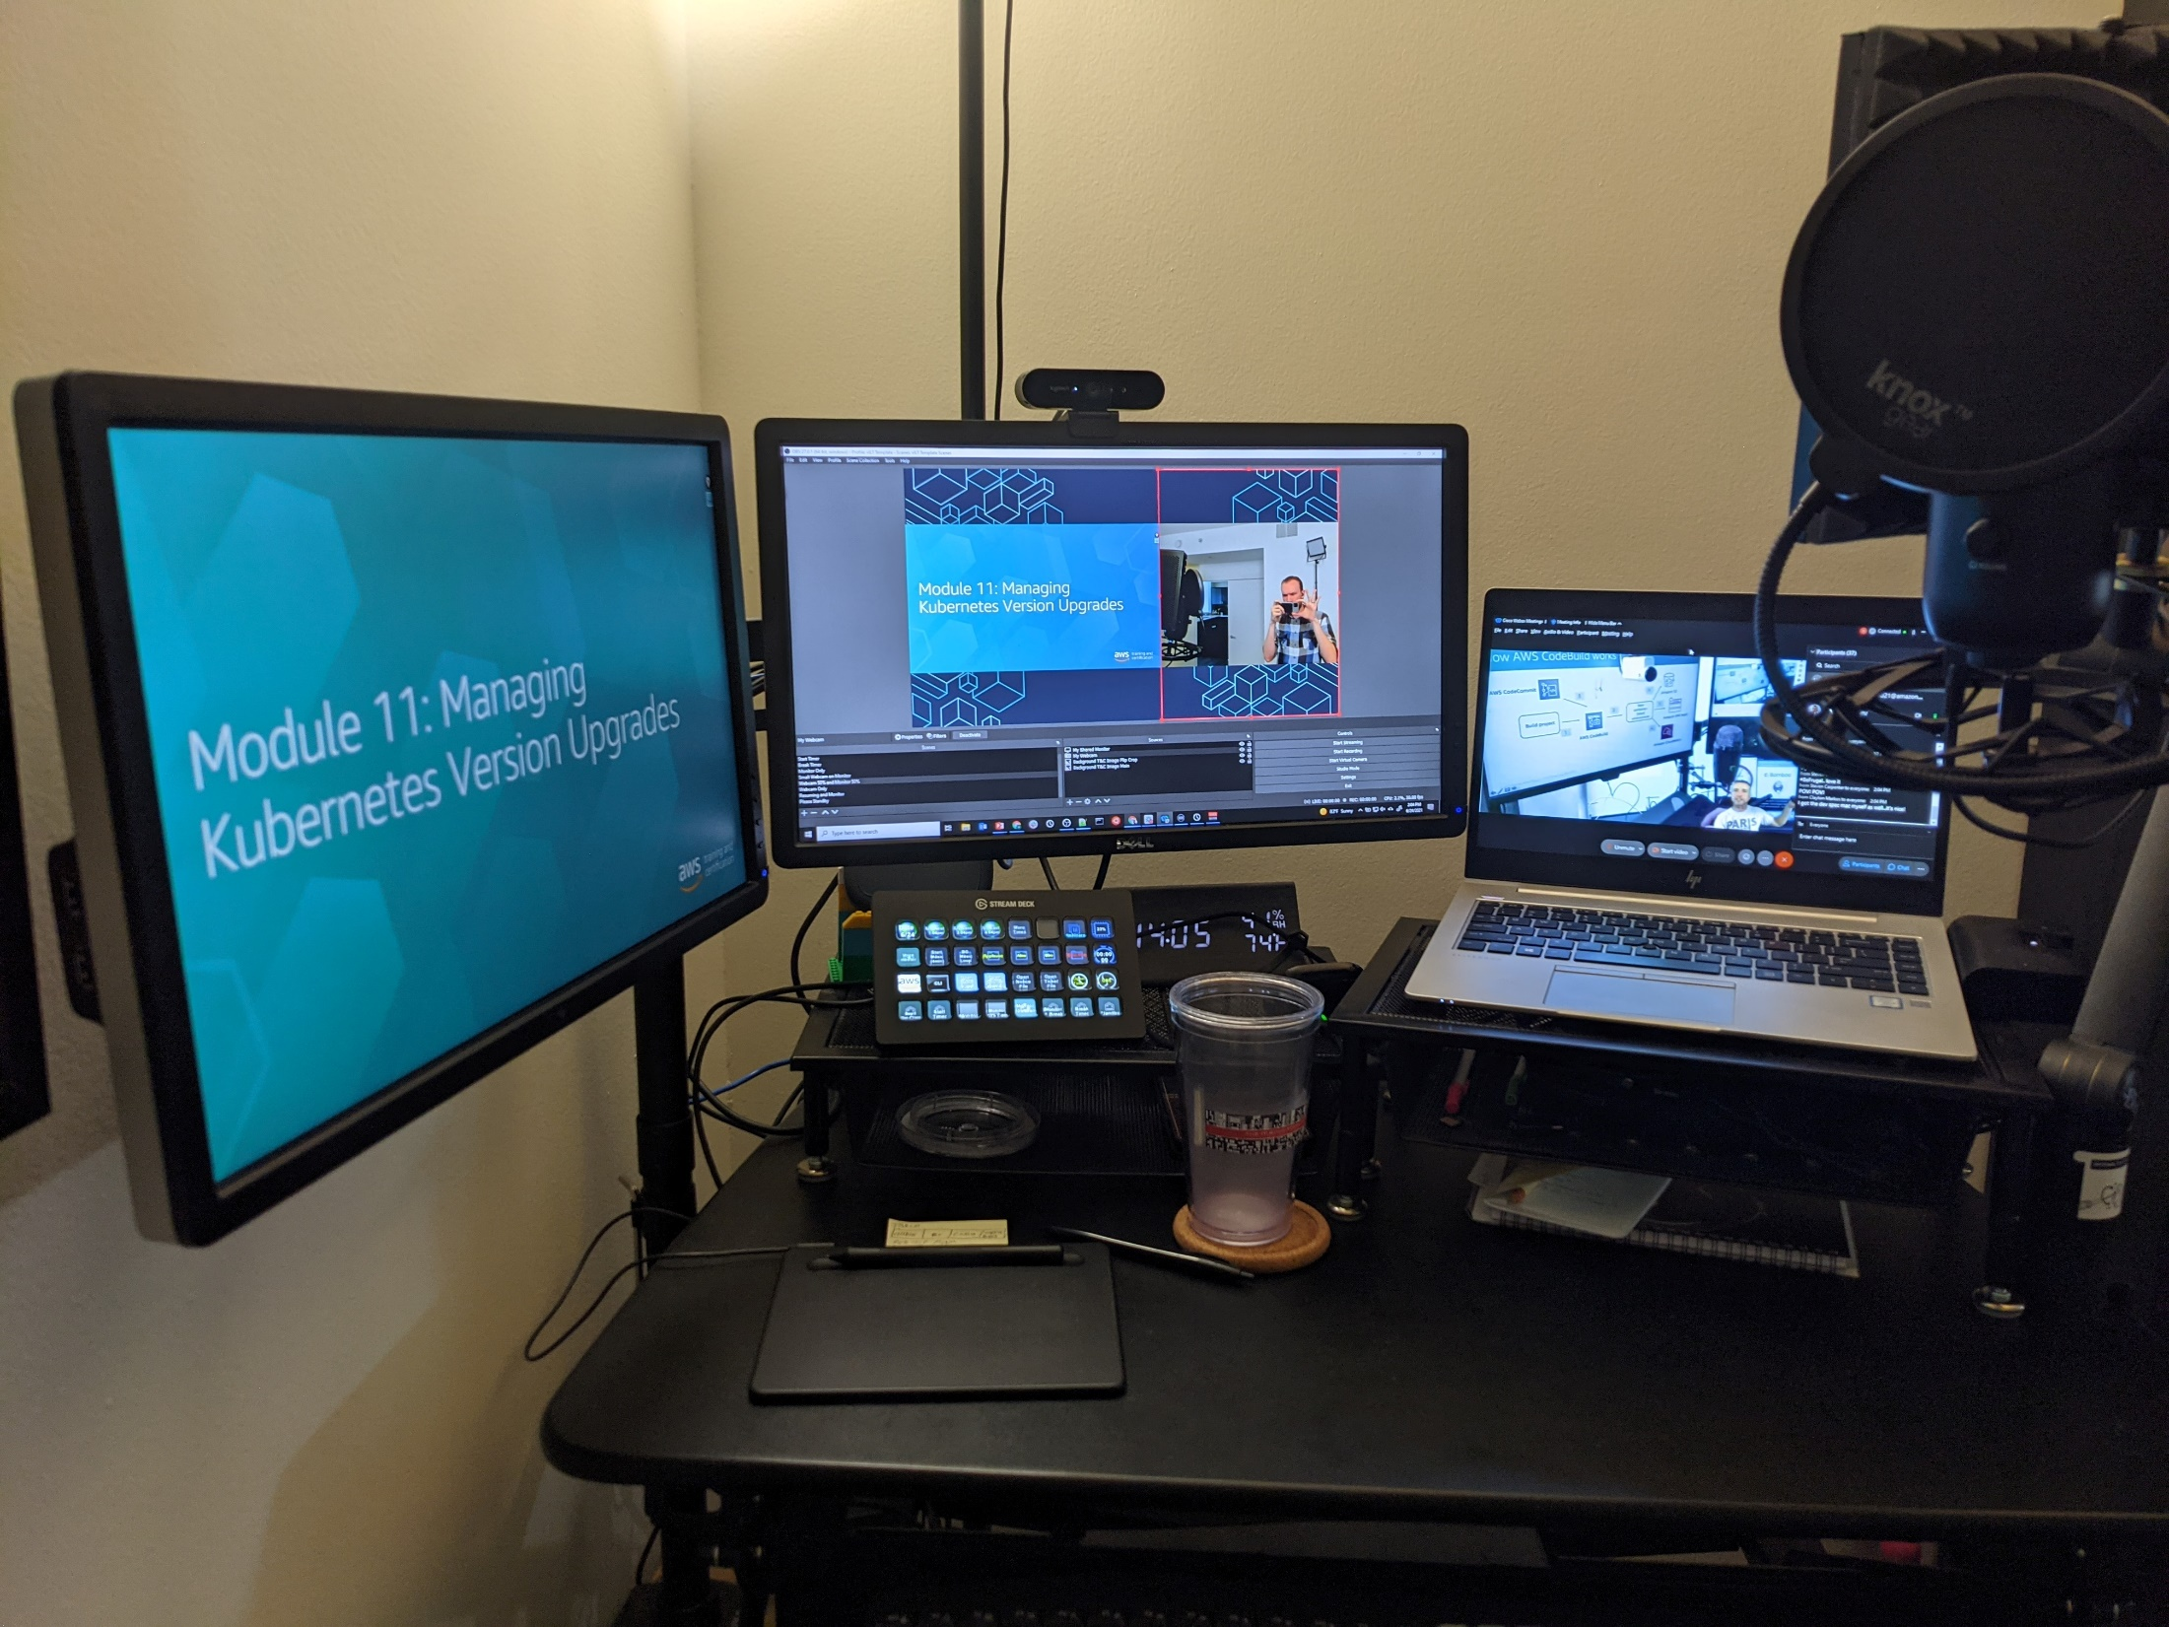
Desk View
Logitech 4K BRIO
Knox Pop Filter
StreamDeck XL (In Front of Hotspot)
Yeti Mic
Pair of 22” Monitors
Base Spec HP Laptop!
Clock!
Monitor Mount
Laptop Dock
Water!
Wacom Intuos S
Yeti Shock Mount
Notes:
Before performing an upgrade of the Kubernetes version or the Amazon EKS version of your cluster, thoroughly review the changes. Upgrade information associated with the new version. Begin your research with these sources:
AWS documentation
AWS documentation contains upgrade information and instructions for both Kubernetes version upgrades and Amazon EKS platform version upgrades. In addition to general information about upgrading, there may be requirements or procedures that are specific to Amazon EKS managed clusters. For information about upgrading Amazon EKS, see “Updating an Amazon EKS cluster Kubernetes version” in the Amazon EKS User Guide (https://docs.aws.amazon.com/eks/latest/userguide/upgrade-cluster.html).
Kubernetes documentation
For Kubernetes version upgrades, be sure to review the release notes and upgrade information in the Kubernetes documentation. The scope of change for even minor Kubernetes version upgrades can vary greatly from version to version, so be sure to properly assess the impact of the upgrade. To identify features that are being deprecated or removed, pay particular attention to changes in the Kubernetes API. For more information about Kubernetes release notes, see “v1.18 Release Notes” in the Kubernetes online documentation (https://kubernetes.io/docs/setup/release/notes/).

Slide 4
Monitor View
PPT SLIDESHOWS,
SHARED APPLICATIONS,
ANNOTATION
PPT PRESENTER VIEW,
NON-SHARED APPLICATIONS
GOTOTRAINING (CLEAN SCREEN),
WEBEX,
OBS PROJECTOR
Notes:
Before performing an upgrade of the Kubernetes version or the Amazon EKS version of your cluster, thoroughly review the changes. Upgrade information associated with the new version. Begin your research with these sources:
AWS documentation
AWS documentation contains upgrade information and instructions for both Kubernetes version upgrades and Amazon EKS platform version upgrades. In addition to general information about upgrading, there may be requirements or procedures that are specific to Amazon EKS managed clusters. For information about upgrading Amazon EKS, see “Updating an Amazon EKS cluster Kubernetes version” in the Amazon EKS User Guide (https://docs.aws.amazon.com/eks/latest/userguide/upgrade-cluster.html).
Kubernetes documentation
For Kubernetes version upgrades, be sure to review the release notes and upgrade information in the Kubernetes documentation. The scope of change for even minor Kubernetes version upgrades can vary greatly from version to version, so be sure to properly assess the impact of the upgrade. To identify features that are being deprecated or removed, pay particular attention to changes in the Kubernetes API. For more information about Kubernetes release notes, see “v1.18 Release Notes” in the Kubernetes online documentation (https://kubernetes.io/docs/setup/release/notes/).

Slide 5
Tool Setup
OBS
Epic Pen
Voicemeeter
Streamdeck
Notes:
This slide summarizes the main points in this lesson.

